Slide 1
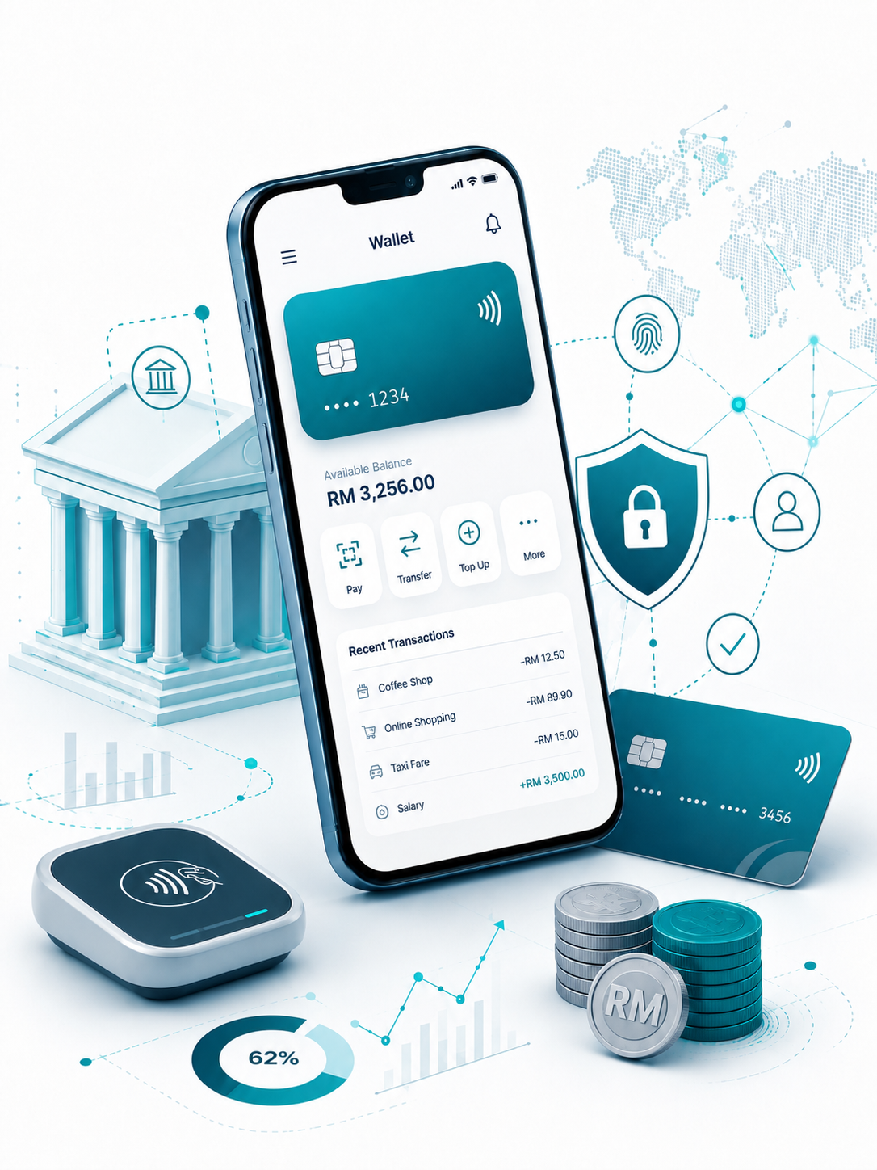

Insert relevant picture related to the topic
TFB3323 FINTECH INNOVATION
WEEK I
INTRODUCTION TO FINTECH
Shuhaida Bt M Shuhidan
(Dr (FSMC/UTP))
BACHELOR OF XXXXXX
DEPARTMENT OF COMPUTING
FACULTY OF SCIENCE, MANAGEMENT & COMPUTING
© 2026 INSTITUTE OF TECHNOLOGY PETRONAS SDN BHD
All rights reserved. No part of this document may be reproduced, stored in a retrieval system or transmitted in any form or by any means (electronic, mechanical, photocopying, recording or otherwise) without the permission of the copyright owner.

Slide 2
LEARNING OUTCOMES
By the end of this session, students will be able to:
Define FinTech and contrast it with traditional banking.
Identify the primary technological and cultural drivers of FinTech.
Explain how "unbundling" and "disintermediation" disrupt traditional finance.
Analyze the key challenges faced by both incumbent banks and FinTech startups.
Recognize major global markets and top Southeast Asian FinTech unicorns.
Notes:
Learning Outcomes Slide
Note:
Include 2–4 lecture-level learning outcomes
Use measurable action verbs
Map explicitly to Course Learning Outcomes (CLOs)

Slide 3
TOPICS
What is FinTech?
1.1. Traditional Banking
1.2. Introduction
2. What is the Problem?
2.1. How did it all begin?
2.2. How long does it take to open a bank account today?
2.3. Why choose technology providers over banks?
Intermediaries & Disintermediation
3.1. Disintermediation
3.2. Features
3.3. FinTech as a Disruptive Force
3.4. The Secret to Success
3.5. Insights
Unbundling – Breaking Up the Value Chain
4.1. “fit-for-single-purpose” solutions
4.2. Breaking Up Traditional Bank Value Chain
FinTech Drivers
5.1. Why FinTech now?
5.2. Drivers
5.3. Distinctive Advantages
5.4. Opportunities
Issues, Threats & Challenges
6.1. Threats Posed by FinTech
6.2. Challenges
China - The largest FinTech market in the World
7.1. Global FinTech VC Investment – Top 15 Global Deals
7.2. Singapore, ASEAN Capital of FinTech
Southeast Asia’s – Top 5 Largest FinTech Unicorn
Notes:
Engagement and Activity Slides
Note:
Include at least one engagement element where appropriate:
Think–Pair–Share
Mini task
Poll or reflection question
Suggested duration: 3–5 minutes
Activities shall align with learning outcomes

Slide 4
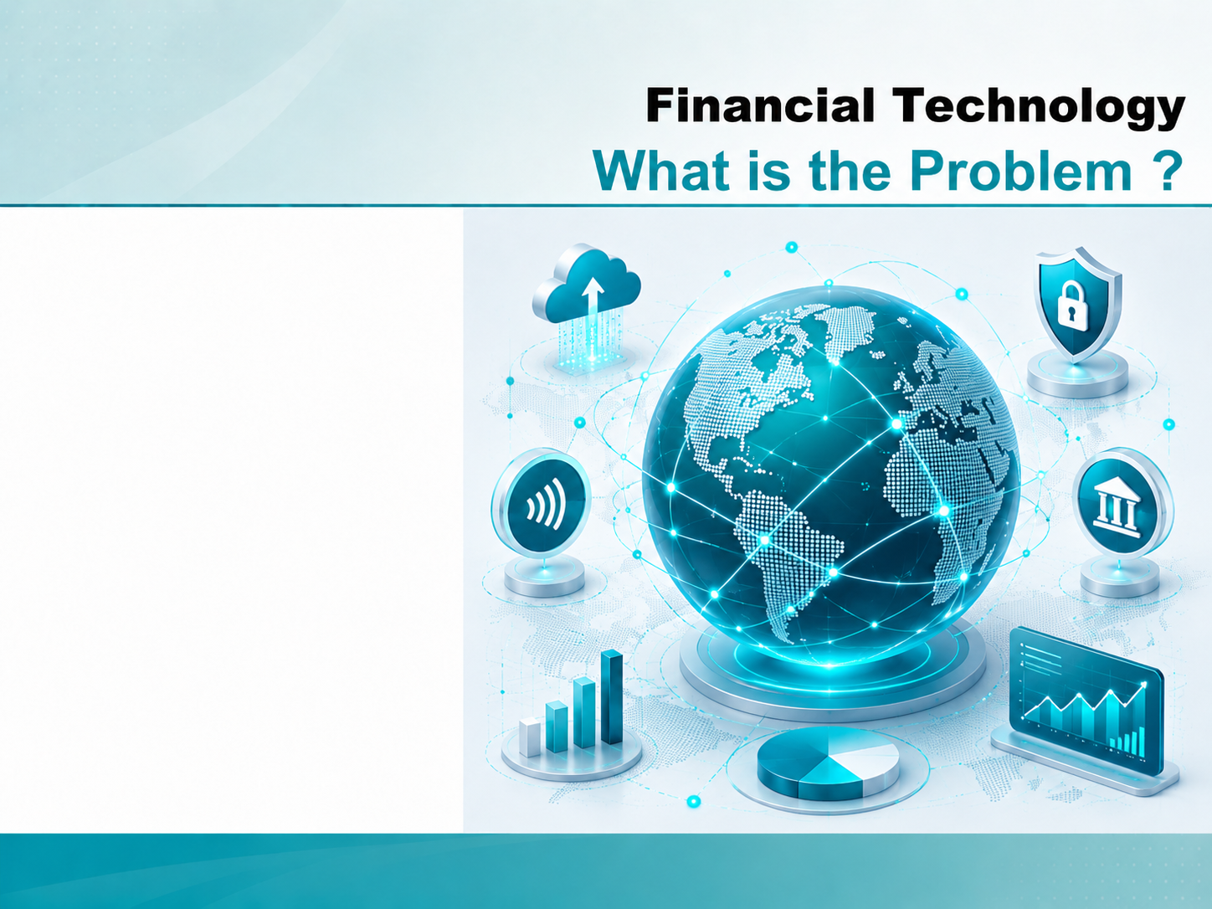
INTRODUCTION TO FINTECH
What is FinTech?

Slide 5
What is FinTech?
1.1. Traditional Banking
At the simplest level, retail banks provide three crucial functions, namely:
They take and provide customers with a secure place to store cash and, backed by deposit insurance and significant regulation.
They through a range of systems, including cash, cards, and transfers.
They lend money.
For centuries, banking has remained fundamentally unchanged. In the simplest terms, banks match savers with borrowers. They pay interest for deposits and make loans to businesses and consumers. Depositors see their savings grow, borrowers use the capital. Banks profit handsomely on the spread.
Notes:
Engagement and Activity Slides
Note:
Include at least one engagement element where appropriate:
Think–Pair–Share
Mini task
Poll or reflection question
Suggested duration: 3–5 minutes
Activities shall align with learning outcomes

Slide 6
What is FinTech? (Traditional Banking)
Banks, as intermediaries, have always added to the cost of borrowing and lending – that’s the price we pay as a society for their market-making abilities. That spread represents a price that was accepted because the banks played a part in the community and served community needs.
The current banking model is fundamentally unfair, due to the costs of using the banking system plus the profits of banks being overwhelmingly accrued from fees and charges that hit the poorest hardest.
Incumbent Banks have traditionally placed themselves at the center of their own universe, while the customer came second. The customer only had access to the bank during opening hours, and always had to play by the bank’s rules
Notes:
Engagement and Activity Slides
Note:
Include at least one engagement element where appropriate:
Think–Pair–Share
Mini task
Poll or reflection question
Suggested duration: 3–5 minutes
Activities shall align with learning outcomes

Slide 7
What is FinTech? (Traditional Banking)
For a long time, new market entrants found it difficult to break into the financial services industry. The large, well-established financial institution that we call ‘incumbents’ had advantages in size, and their networks added a multiplier effect. They had strong compliance systems in place to manage ever-increasing regulations, and they had the client base and resources to prosper even in tough economic conditions.
The term “FinTech,” which is the short form of the phrase financial technology, denotes companies or representatives of companies that combine financial services with modern, innovative technologies. It encompasses a new wave of companies changing the way people pay, send money, borrow, lend, and invest.
Notes:
Engagement and Activity Slides
Note:
Include at least one engagement element where appropriate:
Think–Pair–Share
Mini task
Poll or reflection question
Suggested duration: 3–5 minutes
Activities shall align with learning outcomes

Slide 8
What is FinTech?
1.2. Introduction
The finance industry has been protected because the capabilities that are the bedrock of the industry – trust, economic knowledge, capital management, risk management, capital distribution etc. – have until now been better embodied in large, integrated organizations like banks.
For centuries, banking has remained fundamentally unchanged. In the simplest terms, banks match savers with borrowers. They pay interest for deposits and make loans to businesses and consumers. Depositors see their savings grow; borrowers use the capital. Banks profit handsomely on the spread.
Notes:
Engagement and Activity Slides
Note:
Include at least one engagement element where appropriate:
Think–Pair–Share
Mini task
Poll or reflection question
Suggested duration: 3–5 minutes
Activities shall align with learning outcomes

Slide 9
What is FinTech? (Introduction)
FinTech is about using technology creatively to improve our lives → making banking accessible and affordable.
Fintech → advances in technology that have the potential to transform the provision of financial services, spurring the development of new business models, applications, processes, and products (IMF-World Bank (2018)).
Fintech activities can be observed in different types of financial services, such as deposits, lending and capital raising, insurance, investment management, and payments, clearing, and settlement.
Notes:
Engagement and Activity Slides
Note:
Include at least one engagement element where appropriate:
Think–Pair–Share
Mini task
Poll or reflection question
Suggested duration: 3–5 minutes
Activities shall align with learning outcomes

Slide 10
What is FinTech? (Introduction)
Definition has been adopted by the People’s Bank of China (PBOC) in its FinTech Development Plan (2019–2021) → defines FinTech as technology-enabled innovation in financial services that can result in new business models, applications, processes or products with an associated material effect on the provision of financial services.
New participants in the market offer Internet-based and application-oriented products. FinTechs generally aim to attract customers with products and services that are more user-friendly, efficient, transparent, and automated than those currently available.
Notes:
Engagement and Activity Slides
Note:
Include at least one engagement element where appropriate:
Think–Pair–Share
Mini task
Poll or reflection question
Suggested duration: 3–5 minutes
Activities shall align with learning outcomes

Slide 11
What is FinTech? (Introduction)
The financial industry is undergoing rapid technological change. Traditional banks face competition from online start-ups with no physical branches. Social media and other digital platforms are expanding into payments and credit. The increase in demand for digital services triggered by COVID-19 is turbo-charging this transformation.
It is estimated that global investment in financial technology has increased by almost 100X, from $930 million in 2008 to more than $91.5 billion in 2021.
Notes:
Engagement and Activity Slides
Note:
Include at least one engagement element where appropriate:
Think–Pair–Share
Mini task
Poll or reflection question
Suggested duration: 3–5 minutes
Activities shall align with learning outcomes

Slide 12
INTRODUCTION TO FINTECH
What is the Problem?

Slide 13
What is the Problem?
2.1. How did it all begin?
The birth and rise of FinTech is deeply rooted in the global financial crisis in 2008, and the erosion of trust it generated → people disappointed and angry at the banking system.
Digital natives (a.k.a. millennials) becoming old enough to be potential customers and their preferences pointed to the mobile services they understood and mastered, instead of bankers they could not relate to.
In this favourable landscape, FinTech providers came in, offering new and fresh services at lower costs, through well-designed platforms or mobile apps.
Notes:
Engagement and Activity Slides
Note:
Include at least one engagement element where appropriate:
Think–Pair–Share
Mini task
Poll or reflection question
Suggested duration: 3–5 minutes
Activities shall align with learning outcomes

Slide 14
What is the Problem? (How did it all begin?)
FinTech companies offer trust, transparency, and technology. Responding to a trust crisis towards banks, start ups are able to offer services at a lower cost in a more transparent way, through easy-to-use interfaces. The customer is king and there is no one who knows their customers better than youthful, edgy start-ups, often drawn from the ranks of the millennial generation itself.
The FinTech is providing access to information (that once belonged to a select few) to an ever-increasing pool of people. In our “information economy” age, that is a big democratic move.
Notes:
Engagement and Activity Slides
Note:
Include at least one engagement element where appropriate:
Think–Pair–Share
Mini task
Poll or reflection question
Suggested duration: 3–5 minutes
Activities shall align with learning outcomes

Slide 15
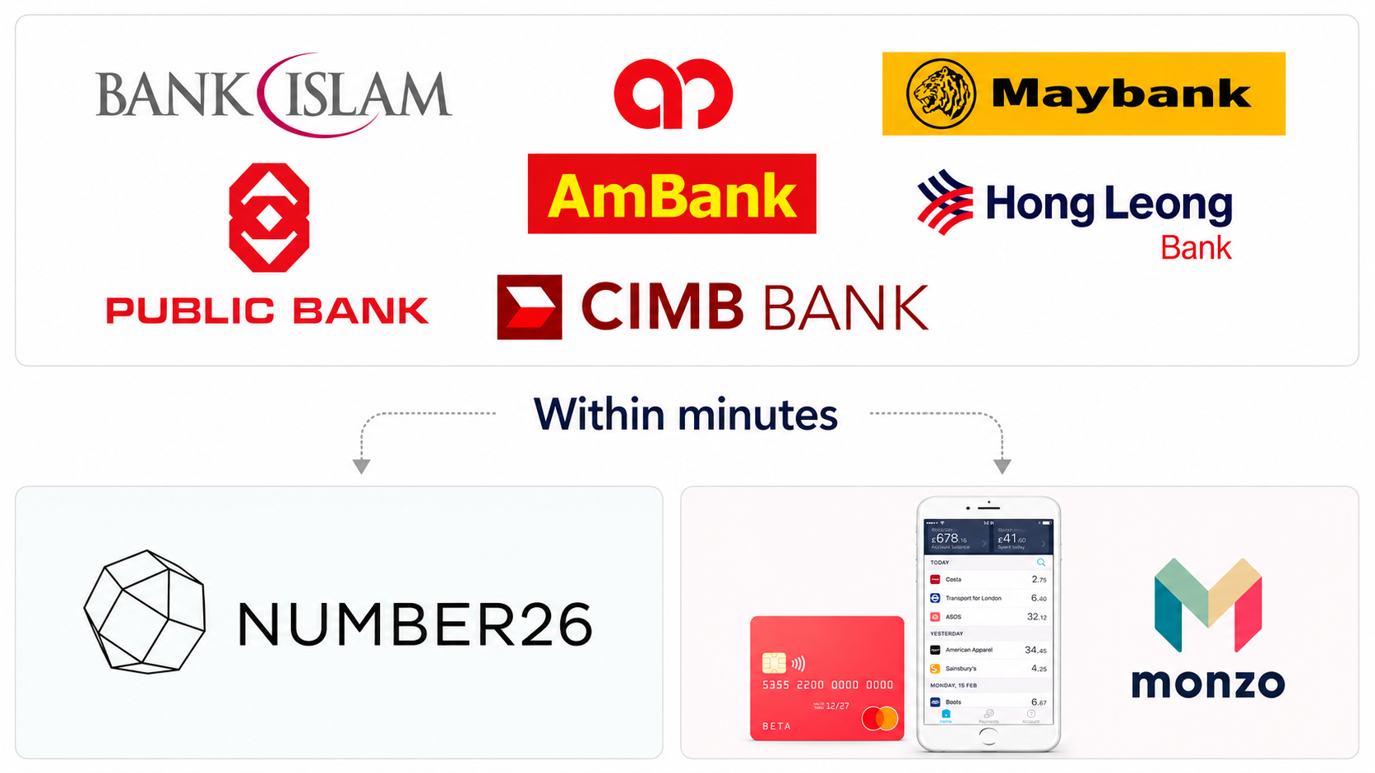
What is the Problem?
2.2. How long does it take to open a bank account today?
Notes:
Engagement and Activity Slides
Note:
Include at least one engagement element where appropriate:
Think–Pair–Share
Mini task
Poll or reflection question
Suggested duration: 3–5 minutes
Activities shall align with learning outcomes

Slide 16
What is the Problem?
2.3. How Why choose technology providers over banks
According to a TransferWise survey, the five main factors that prompt consumers to choose technology providers over banks are as follows:
a more secure service than banks (34%),
a lower cost than banks (29%),
a more convenient service than banks (26%),
a quicker service than banks (18%),
a better customer service than banks (18%).
Notes:
Engagement and Activity Slides
Note:
Include at least one engagement element where appropriate:
Think–Pair–Share
Mini task
Poll or reflection question
Suggested duration: 3–5 minutes
Activities shall align with learning outcomes

Slide 17
INTRODUCTION TO FINTECH
Intermediaries
&
Disintermediation

Slide 18
Intermediaries & Disintermediation
3.1. Disintermediation
As these new (fintech) systems are markets, not banks, this is a potentially disruptive model. The reasons are…
By cutting out the middleman the system promises lower interest rates to borrowers and higher returns to lenders if they actively manage their lending;
The lender, not the service, carries the risk of bad debt;
The agent is not required to maintain any liquidity;
The agents’ returns are volume-based rather than risk based
The current wave of innovation, built as it is on the progressive digitization of the society and by the incremental technology now available and pushed forward by “fintech” new players, has a number of clearly identifiable features:
Notes:
Engagement and Activity Slides
Note:
Include at least one engagement element where appropriate:
Think–Pair–Share
Mini task
Poll or reflection question
Suggested duration: 3–5 minutes
Activities shall align with learning outcomes

Slide 19
Intermediaries & Disintermediation
3.2. Features
The current wave of innovation, built as it is on the progressive digitization of society and by the incremental technology now available and pushed forward by “fintech” new players, has several clearly identifiable features:
It has now become more deliberate and targeted, often at the harm of traditional banks, as incumbents are perceived more and more as inefficient, overregulated, and mostly unable to react in a prompt way.
Notes:
Engagement and Activity Slides
Note:
Include at least one engagement element where appropriate:
Think–Pair–Share
Mini task
Poll or reflection question
Suggested duration: 3–5 minutes
Activities shall align with learning outcomes

Slide 20
Intermediaries & Disintermediation - Features
The focus of the competitive attack from digital players has become mostly associated with the greatest sources of clients’ friction and pain in their relationship with existing incumbents.
Eg → the time to answer in lending, ranging from many weeks to a few months for the incumbents and approaching real time for some of the new web-based digital lenders, → using sophisticated psychometric analysis, as well as all kinds of applied analytics techniques to mine unstructured sources of data, both “formal” and “social”
Notes:
Engagement and Activity Slides
Note:
Include at least one engagement element where appropriate:
Think–Pair–Share
Mini task
Poll or reflection question
Suggested duration: 3–5 minutes
Activities shall align with learning outcomes

Slide 21
Intermediaries & Disintermediation - Features
It has the greatest impact where the new digital challengers can employ business models that are platform-based, data-intensive, and capital light, or capital-less
Eg. → As technology is mostly providing the transformation of information into intelligence, it has also become clear that long dated banks’ trust (significantly tarnished after the global financial crisis and the many scandals related to misconduct—from misspelling to market rates manipulation to money laundering etc.) can be eventually replaced by the brand value of new digital players—new names and logos not even present few years ago.
Notes:
Engagement and Activity Slides
Note:
Include at least one engagement element where appropriate:
Think–Pair–Share
Mini task
Poll or reflection question
Suggested duration: 3–5 minutes
Activities shall align with learning outcomes

Slide 22
Intermediaries & Disintermediation - Features
It has most immediate effects on very specific processes, whilst impacting significantly the global functions performed by the financial system at large, it is therefore starting in a very vertical, surgical way to then expand horizontally across the overall financial services value chain, to reach and get hold of the client.
It needs to change almost continuously, as incumbents naturally try to react with similar strategies, leveraging their legacy assets, often ending up providing the very digital challengers the infrastructure and the services they require to compete in new ways and forms.
Notes:
Engagement and Activity Slides
Note:
Include at least one engagement element where appropriate:
Think–Pair–Share
Mini task
Poll or reflection question
Suggested duration: 3–5 minutes
Activities shall align with learning outcomes

Slide 23
Intermediaries & Disintermediation
3.3. FinTech as a Disruptive Force
Fintech is a disruptive force in the financial services system, essentially for the following reasons:
Unbundling: Historically, large financial institutions served as one-stop shops and could count on their loyal customers to turn to them for all of their financial needs. More and more customers are eager to shop around and are comfortable using multiple providers to fulfill their financial services needs.
Creating better, more innovative products and services: Thanks in part to the unbundling trend, fintech startups often have the opportunity to create better products and services than their entrenched competitors.
Notes:
Engagement and Activity Slides
Note:
Include at least one engagement element where appropriate:
Think–Pair–Share
Mini task
Poll or reflection question
Suggested duration: 3–5 minutes
Activities shall align with learning outcomes

Slide 24
Intermediaries & Disintermediation – FinTech as a Disruptive Force
Improving customer experience: Traditional financial institutions did not have to worry about customer experience because of the historical lock-in they held. Fintech companies use customer experience as a key point of differentiation. This gives them a real edge in customer acquisition and retention.
Offering better pricing: Fintech upstarts are exploiting increased consumer sophistication and decreased trust in large financial services providers to create offerings that have more compelling pricing.
Targeting underserved markets: Many fintech startups hope not only to build a business serving the underserved markets, but also to leverage them as footholds for later expansion into other markets or upselling to their initial market
Notes:
Engagement and Activity Slides
Note:
Include at least one engagement element where appropriate:
Think–Pair–Share
Mini task
Poll or reflection question
Suggested duration: 3–5 minutes
Activities shall align with learning outcomes

Slide 25
Intermediaries & Disintermediation
3.4. The Secret to Success
The following are:
Best Customer Experience: Customer is at the forefront… innovating for the customer (Apple).
Asset Light Operations: No big factories… such as Uber (they don’t have taxis, they don’t have employees), AirBnB…they are just marketplaces → connecting one person with another
Notes:
Engagement and Activity Slides
Note:
Include at least one engagement element where appropriate:
Think–Pair–Share
Mini task
Poll or reflection question
Suggested duration: 3–5 minutes
Activities shall align with learning outcomes

Slide 26
Intermediaries & Disintermediation
3.5. Insights
High-level insights on innovation in financial services:
Innovation in financial services is deliberate and predictable; incumbent players are most likely to be attacked where the greatest sources of customer friction meet the largest profit pools.
The most imminent effects of disruption will be felt in the banking sector; however, the greatest impact of disruption is likely to be felt in the insurance sector
Notes:
Engagement and Activity Slides
Note:
Include at least one engagement element where appropriate:
Think–Pair–Share
Mini task
Poll or reflection question
Suggested duration: 3–5 minutes
Activities shall align with learning outcomes

Slide 27
Intermediaries & Disintermediation
3.5. Insights
High-level insights on innovation in financial services:
Innovation in financial services is deliberate and predictable; incumbent players are most likely to be attacked where the greatest sources of customer friction meet the largest profit pools.
The most imminent effects of disruption will be felt in the banking sector; however, the greatest impact of disruption is likely to be felt in the insurance sector
Notes:
Engagement and Activity Slides
Note:
Include at least one engagement element where appropriate:
Think–Pair–Share
Mini task
Poll or reflection question
Suggested duration: 3–5 minutes
Activities shall align with learning outcomes

Slide 28
INTRODUCTION TO FINTECH
Unbundling
Breaking Up the
Value Chain

Slide 29
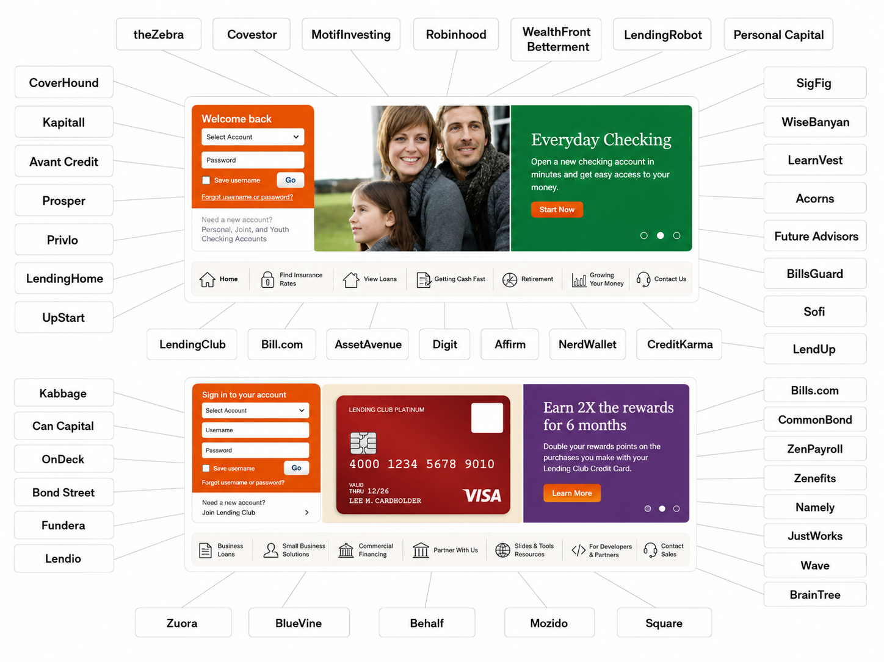
Traditional bank value chain is breaking up and Fin Tech start-ups are attacking valuable parts with fit-for-single-purpose solutions
Notes:
Engagement and Activity Slides
Note:
Include at least one engagement element where appropriate:
Think–Pair–Share
Mini task
Poll or reflection question
Suggested duration: 3–5 minutes
Activities shall align with learning outcomes

Slide 30
Unbundling – Breaking Up the Value Chain
4.1. FinTech – “fit-for-single-purpose” solutions
Fintech players, in particular, are ..:
Attacking valuable specific components of such value chain and with “fit-for-single-purpose” solutions.
Their efficacy is then magnified, as they just on a single, tiny component (a service, or product), to make it much more valuable and competitive with what currently offered.
And then using this single attack point to disaggregate further the original banks’ service proposition and gain larger shares of it towards the end customer.
Notes:
Engagement and Activity Slides
Note:
Include at least one engagement element where appropriate:
Think–Pair–Share
Mini task
Poll or reflection question
Suggested duration: 3–5 minutes
Activities shall align with learning outcomes

Slide 31
Unbundling – Breaking Up the Value Chain
4.2. FinTech – Breaking Up Traditional Bank Value Chain
While banks try to offer a wide scope of services, there are many innovative FinTech companies that just on the development of one simple service with great user experience. This certainly makes the lives of banks harder, as it is simply impossible for a large organization to achieve sustainable growth in every niche of the financial services sector.
This development refers to the “unbundling” trend, meaning that FinTech firms focus on distinct areas of banking with the goal to become the “best of breed” providers in these areas. Therefore, on an aggregate level there is a danger that the banking service offering overall is “unbundled” by the best FinTech providers in each category.
Notes:
Engagement and Activity Slides
Note:
Include at least one engagement element where appropriate:
Think–Pair–Share
Mini task
Poll or reflection question
Suggested duration: 3–5 minutes
Activities shall align with learning outcomes

Slide 32
Unbundling – Breaking Up the Value Chain
While New entrants are thus breaking up in a number of ways the different banking value chains and with relevant implications on most (if not all) of the fundamental functions of the global financial system, including:
Payments and settlements, where electronic payments and digital currencies are now changing how consumers pay for their consumptions, and where new technologies such as the “distributed ledgers” (Blockchain) one offers potentially a radical disruption of the system, with almost unlimited savings on cost structures;
Funding, where new direct lending opportunities, and even equity raises opportunities via crowd funding initiatives, are now operated through digital channels and available almost real time because of the mining and analysis of a multitude of structured and unstructured data, that can now connect borrowers and savers directly, allowing a better matching of demand and supply complementary risk/return profiles;
Notes:
Engagement and Activity Slides
Note:
Include at least one engagement element where appropriate:
Think–Pair–Share
Mini task
Poll or reflection question
Suggested duration: 3–5 minutes
Activities shall align with learning outcomes

Slide 33
Unbundling – Breaking Up the Value Chain
Asset management, where robot-advisers (based on artificial intelligence—AI— techniques and software) are now making sophisticated financial consulting on asset allocation available to almost anyone at a marginal cost approaching zero—allowing also faster responses and continuous monitoring;
Investment banking, where frequency trading is now almost completely operated by AI systems, and new B2B platforms such as dark pools, usually operated by consortia of global investment banks) allow now a direct and more efficient (if not less regulated and supervised) link between buyers and sellers;
Insurance, where new technologies such as self-driving cars, internet of things, shared economy applied to durable goods and fixed assets such as apartments and offices are progressively revolutionizing the traditional risk underwriting, insurance and re-insurance activities, not to mention the brokerage ones.
Notes:
Engagement and Activity Slides
Note:
Include at least one engagement element where appropriate:
Think–Pair–Share
Mini task
Poll or reflection question
Suggested duration: 3–5 minutes
Activities shall align with learning outcomes

Slide 34
Unbundling – Breaking Up the Value Chain
Corporate incumbents can’t match the speed to market and the ability to innovate that the best FinTech developers bring to the table. So, rather than trying to reinvent the wheel by developing their own solutions, banks will have to work with innovators to bring new services to their consumers.
Notes:
Engagement and Activity Slides
Note:
Include at least one engagement element where appropriate:
Think–Pair–Share
Mini task
Poll or reflection question
Suggested duration: 3–5 minutes
Activities shall align with learning outcomes

Slide 35
INTRODUCTION TO FINTECH
FinTech
Drivers

Slide 36
FinTech – Drivers
5.1. Why FinTech Now?
Disruption is also occurring because customers’ experiences with technological leaders in other sectors are transforming their expectations of banking & insurance customer service.
Consumers do not now judge their customer experience of an FS/insurance company against that of other FS/insurance companies, but instead judge it against their superior experiences with digital leaders such as Amazon, Google.
Yet FS/insurers still tend to benchmark themselves against other FS/insurers instead of benchmarking against possible external disruptors.
Notes:
Engagement and Activity Slides
Note:
Include at least one engagement element where appropriate:
Think–Pair–Share
Mini task
Poll or reflection question
Suggested duration: 3–5 minutes
Activities shall align with learning outcomes

Slide 37
FinTech – Drivers
Today (Dec 2023), as consumers confront high inflation, rising interest rates and uncertain markets, there is a growing sense that fintech will play a central role in helping consumers to manage their financial situations. Over half of Americans (53%) and more than six in ten Brits (62%) say their financial stress has increased over the past year. A similar proportion (61%) of respondents believe digital financial tools will help them weather economic challenges.
Trends over the past three years (2019-2022) show that fintech’s positive everyday impact has led to sustained consumer appetite for technology-driven financial innovation.
Notes:
Engagement and Activity Slides
Note:
Include at least one engagement element where appropriate:
Think–Pair–Share
Mini task
Poll or reflection question
Suggested duration: 3–5 minutes
Activities shall align with learning outcomes

Slide 38
FinTech – Drivers
Inflation has dragged down financial confidence but consumers say fintech is helping them weather the economic storm. Beyond access to their finances from anywhere, consumers seek stability from payments and liquidity management applications, and use savings tools to meet short- and long-term goals.
As financial markets face volatility, consumers across the income spectrum turn to their investment applications to stay on top of their holdings and navigate inflationary times..
Notes:
Engagement and Activity Slides
Note:
Include at least one engagement element where appropriate:
Think–Pair–Share
Mini task
Poll or reflection question
Suggested duration: 3–5 minutes
Activities shall align with learning outcomes

Slide 39
FinTech – Drivers
Four key factors are driving Fintech innovation in the global financial services industry:
Consumer behavior and expectations in regard to financial services have changed.
Artificial Intelligence (AI) cloud computing and big data have created an affordable infrastructure.
New currencies (esp. the promise of digital currencies) and credit systems have impacted investment and banking.
Due to mobile phone and other improved access methods, the barriers to entry in the financial services industry are being reduced.
Notes:
Engagement and Activity Slides
Note:
Include at least one engagement element where appropriate:
Think–Pair–Share
Mini task
Poll or reflection question
Suggested duration: 3–5 minutes
Activities shall align with learning outcomes

Slide 40
FinTech – Drivers
Frustration
CX, Cost and Convenience
Trust and Transparency
Emerging technologies
Easy to use interface → better CX
Mobile culture / smartphones
Power of mobile
Social Media. By prioritising 24/7 access, FinTechs offer services available via non-traditional channels such as social media, empowering customers to a great extent.
Notes:
Engagement and Activity Slides
Note:
Include at least one engagement element where appropriate:
Think–Pair–Share
Mini task
Poll or reflection question
Suggested duration: 3–5 minutes
Activities shall align with learning outcomes

Slide 41
FinTech – Drivers
Millennials . Millennials don’t trust banks. They trust Google, Amazon, Facebook, Apple, …. Many reports show that millennials are disappointed with the level of bank services and are less faithful customers. However, at the same time, they are more willing to use new technologies.
Liquidity is a powerful driver. People (poor and middle income) need cash quickly (now) to solve immediate problem.
The underbanked and the unbanked. …30 % of US population, 2 billion globally.
Notes:
Engagement and Activity Slides
Note:
Include at least one engagement element where appropriate:
Think–Pair–Share
Mini task
Poll or reflection question
Suggested duration: 3–5 minutes
Activities shall align with learning outcomes

Slide 42
FinTech – Drivers
As the global economy emerged from the crisis, it became clear that many customers, and especially the younger generations, the so-called millennials, had lost faith in the traditional financial services. From their point of view, FIs were the root cause of the financial and economic crisis. To make matters worse, those agents had only managed to avoid bankruptcy thanks to continuing massive injections or support of public money . If the banks themselves were incapable of managing the risks they took, why should anyone take their advice or trust them with their savings?
Old and new generations of customers are willing to turn their backs on the traditional players. They are keen to see new companies emerge that played no part in the recent crisis and could offer innovative solutions to financial services.
Notes:
Engagement and Activity Slides
Note:
Include at least one engagement element where appropriate:
Think–Pair–Share
Mini task
Poll or reflection question
Suggested duration: 3–5 minutes
Activities shall align with learning outcomes

Slide 43
FinTech – Drivers
5.1. Distinctive Advantages?
Whatever the positioning of these digital challengers along the value chain, they all share (with different weight) a number of built on digital technology innovation, avoidance of regulation and a superior understanding of client needs, usually born out of their used to gather, mine and interpret “big data”—structured and not, quantitative and qualitative, formal and social—coming for example from the analysis and monitoring of our reputation in the web, to discriminate on our somehow related creditworthiness; or from the information available from all kind of sources that offers new lead and lag indicators on the state of health of a business
Notes:
Engagement and Activity Slides
Note:
Include at least one engagement element where appropriate:
Think–Pair–Share
Mini task
Poll or reflection question
Suggested duration: 3–5 minutes
Activities shall align with learning outcomes

Slide 44
FinTech – Drivers
5.1. Opportunities?
Opportunities. Fintech offers wide-ranging opportunities which national authorities are keen to foster. It holds the promise of reducing costs and frictions, increasing efficiency and competition, narrowing information asymmetry, and broadening access to financial services—especially in low-income countries and for underserved population — although the benefits of technological change may take time to fully materialize.
Ongoing innovations and technological advances support broader economic development and inclusive growth, facilitate international payments and remittances, and simplify and strengthen regulatory compliance and supervisory processes.
Notes:
Engagement and Activity Slides
Note:
Include at least one engagement element where appropriate:
Think–Pair–Share
Mini task
Poll or reflection question
Suggested duration: 3–5 minutes
Activities shall align with learning outcomes

Slide 45
INTRODUCTION TO FINTECH
Issues, Threats & Challenges

Slide 46
Issues, Threats & Challenges
6.1. Threats Posed by FinTech (faced by incumbents)
Threats posed by FinTechs have the ability to disrupt categories of incumbents’ business…
Erode brand equity
market share,
margins,
information security/privacy
customer churn
Notes:
Engagement and Activity Slides
Note:
Include at least one engagement element where appropriate:
Think–Pair–Share
Mini task
Poll or reflection question
Suggested duration: 3–5 minutes
Activities shall align with learning outcomes

Slide 47
Issues, Threats & Challenges
6.2. Challenges (faced by incumbents)
Today, financial institutions face several challenges. They can be summarized as the six C’s:
Culture
acting customer-centric;
balancing the interests of the shareholders and the organization;
being lean, automated, and agile.
Customers
empowered and demanding;
complex and confused;
sometimes malicious.
Notes:
Engagement and Activity Slides
Note:
Include at least one engagement element where appropriate:
Think–Pair–Share
Mini task
Poll or reflection question
Suggested duration: 3–5 minutes
Activities shall align with learning outcomes

Slide 48
Issues, Threats & Challenges
Competition
More and more aggressive
Global
Computers
Based on new technology
Always connected to networks
Available through other devices, such as the mobile ones.
Notes:
Engagement and Activity Slides
Note:
Include at least one engagement element where appropriate:
Think–Pair–Share
Mini task
Poll or reflection question
Suggested duration: 3–5 minutes
Activities shall align with learning outcomes

Slide 49
Issues, Threats & Challenges
Compliance
more fraud;
need for security;
increasing legislation and regulation;
governance, risk, and compliance (GRC) management.
Costs
Hugh push for improving the return on equity;
More outsourcing.
Notes:
Engagement and Activity Slides
Note:
Include at least one engagement element where appropriate:
Think–Pair–Share
Mini task
Poll or reflection question
Suggested duration: 3–5 minutes
Activities shall align with learning outcomes

Slide 50
Issues, Threats & Challenges
A common challenge FinTech companies and incumbents face is regulatory uncertainty . FinTech represents a challenge to regulators, as there may be a risk of an uneven playing field between the FS and FinTech companies. In fact, 86% of FS CEOs are concerned about the impact of overregulation on their prospects for growth, making this the biggest threat to growth they face.
However, the problems do not correspond to specific regulations, but rather to ambiguity and confusion.
Notes:
Engagement and Activity Slides
Note:
Include at least one engagement element where appropriate:
Think–Pair–Share
Mini task
Poll or reflection question
Suggested duration: 3–5 minutes
Activities shall align with learning outcomes

Slide 51
Issues, Threats & Challenges
Regulatory Compliance
Regulatory regimes in many jurisdictions have become markedly more open to, and in some cases even supportive of, fintech innovators.
Despite these changes, the regulatory barriers to entry remain particularly high, and while a growing number of regulators are providing guidance to fintech firms, they do not look kindly on firms who are lackadaisical toward their compliance responsibilities.
Further complicating this issue is the fact that regulations and licensing requirements differ across jurisdictions, and sometimes even within countries.
Notes:
Engagement and Activity Slides
Note:
Include at least one engagement element where appropriate:
Think–Pair–Share
Mini task
Poll or reflection question
Suggested duration: 3–5 minutes
Activities shall align with learning outcomes

Slide 52
Issues, Threats & Challenges
Industry players are asking, which regulatory agencies govern FinTech companies? Which rules do FinTech companies have to abide by? And specifically, which FinTech companies have to adhere to which regulations?
In particular, small players struggle to navigate a complex, ever-increasing regulatory compliance environment as they strive to define their compliance model. Recent years have brought an increase of regulations in the FS industry, where even long-standing players are struggling to keep up.
Notes:
Engagement and Activity Slides
Note:
Include at least one engagement element where appropriate:
Think–Pair–Share
Mini task
Poll or reflection question
Suggested duration: 3–5 minutes
Activities shall align with learning outcomes

Slide 53
Issues, Threats & Challenges
Access to Talent
All fintechs seek to use agile operating models and unique technologies to gain a competitive edge. Achieving this ‘edge’ requires the right people with necessary skills to make a founder’s vision a reality, whether that entails designing a new and more intuitive customer experience, or designing a machine learning-enabled regtech system.
Even when individuals with the right skills are available, fintechs must overcome significant competition to hire these individuals.
Notes:
Engagement and Activity Slides
Note:
Include at least one engagement element where appropriate:
Think–Pair–Share
Mini task
Poll or reflection question
Suggested duration: 3–5 minutes
Activities shall align with learning outcomes

Slide 54
Issues, Threats & Challenges
Scaling the Customer Base
While a number of celebrated fintech unicorns have been able to rapidly acquire a significant user base and broad geographic penetration in just a few years, this does not mean starting such fintech businesses is easy, let alone scaling them. However, the nature of this challenge differs significantly depending on if the target customers are end consumers (B2C) or large institutions (B2B).
The business model of many B2C fintech startups requires them to build an enormous customer base to achieve profitability.
Notes:
Engagement and Activity Slides
Note:
Include at least one engagement element where appropriate:
Think–Pair–Share
Mini task
Poll or reflection question
Suggested duration: 3–5 minutes
Activities shall align with learning outcomes

Slide 55
Issues, Threats & Challenges
Take digital bank Revolut as an example. To fuel its growth, acquire clients, and be able to offer products at highly competitive fees, the company has had to spend millions (around £8 million according to some reports) and has not yet achieved profitability. This is only possible if the company has a lot of funding and patient investors.
For robo-advisory firms, the cost of customer acquisition for a very low-margin product has proved to be particularly high, with Morningstar estimating a cost between US$300 and US$1000 to acquire each new client.
Notes:
Engagement and Activity Slides
Note:
Include at least one engagement element where appropriate:
Think–Pair–Share
Mini task
Poll or reflection question
Suggested duration: 3–5 minutes
Activities shall align with learning outcomes

Slide 56
Issues, Threats & Challenges
Raising Capital
While the global pool of available venture capital has grown in recent years, competition for investment remains fierce for any startup, and fintechs are no exception.
Adding further complexity, high regulatory requirements of the sector increase the complexity of product launch.
Cybersecurity
Hacks, security breaches. As the technologies advance, so too do hackers’ abilities and resources. The nature of attackers has grown. They are highly organized. In some cases, they might even be nation-states. There are substantial risks for the industry. Fintech initiatives might suffer from the risks involved with them.
Notes:
Engagement and Activity Slides
Note:
Include at least one engagement element where appropriate:
Think–Pair–Share
Mini task
Poll or reflection question
Suggested duration: 3–5 minutes
Activities shall align with learning outcomes

Slide 57
Issues, Threats & Challenges
6.1. Challenges (Cultural)
There is a cultural challenge on how traditional financial institutions accept technology. Without fintech innovation, there is a risk of technology complacency and eventual obsolescence relative to other countries. Without taking some steps to advance their financial technologies, financial institutions in some countries risk losing competitive advantage by allowing their financial environment to become non-competitive in the global marketplace.
For example, the South Korean government realizes that fintech initiatives are changing the nature of financial services. The industry there is highly regulated, and the government worries about the viability of its existing banking infrastructure going forward.
Notes:
Engagement and Activity Slides
Note:
Include at least one engagement element where appropriate:
Think–Pair–Share
Mini task
Poll or reflection question
Suggested duration: 3–5 minutes
Activities shall align with learning outcomes

Slide 58
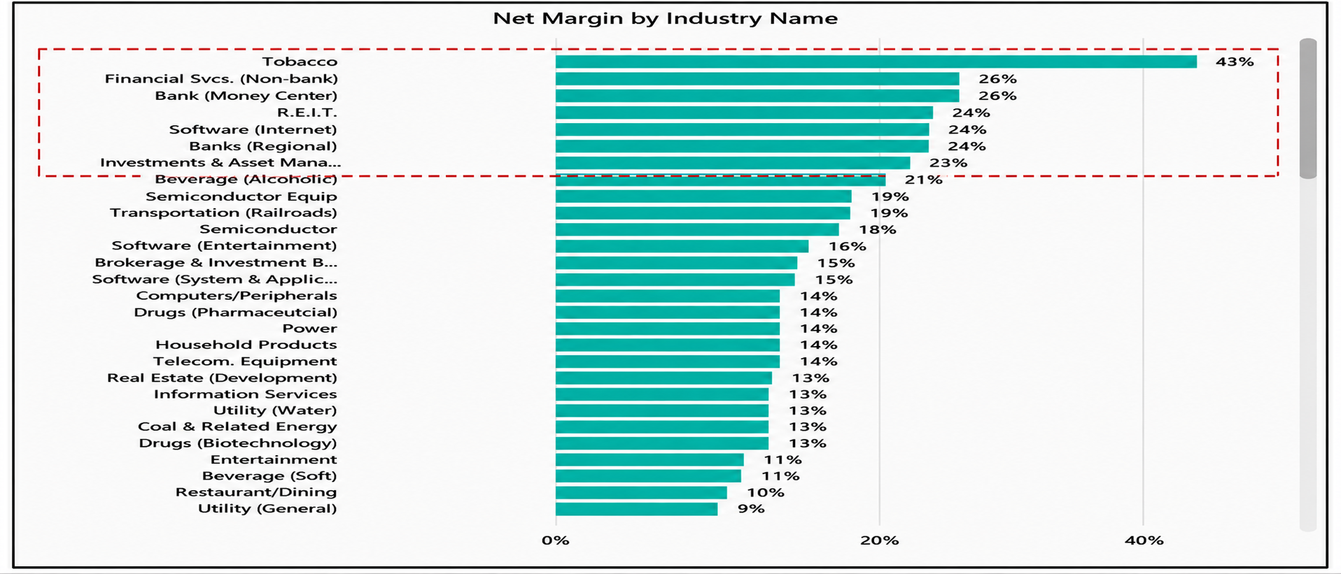
Issues, Threats & Challenges
Notes:
Engagement and Activity Slides
Note:
Include at least one engagement element where appropriate:
Think–Pair–Share
Mini task
Poll or reflection question
Suggested duration: 3–5 minutes
Activities shall align with learning outcomes

Slide 59
INTRODUCTION TO FINTECH
China – The Largest FinTech market in the
World

Slide 60
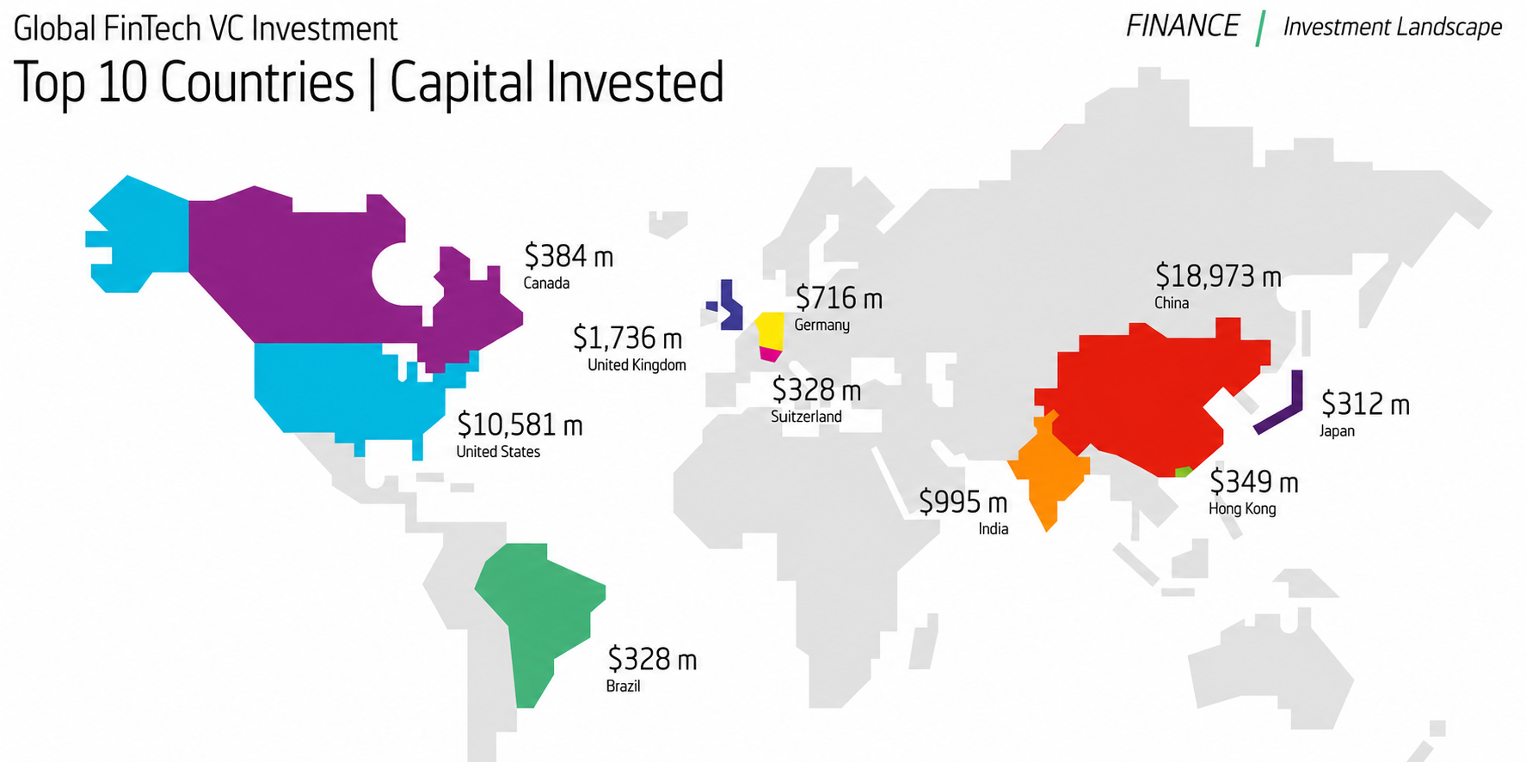
China – the Largest FinTech Market in the World
Notes:
Engagement and Activity Slides
Note:
Include at least one engagement element where appropriate:
Think–Pair–Share
Mini task
Poll or reflection question
Suggested duration: 3–5 minutes
Activities shall align with learning outcomes

Slide 61
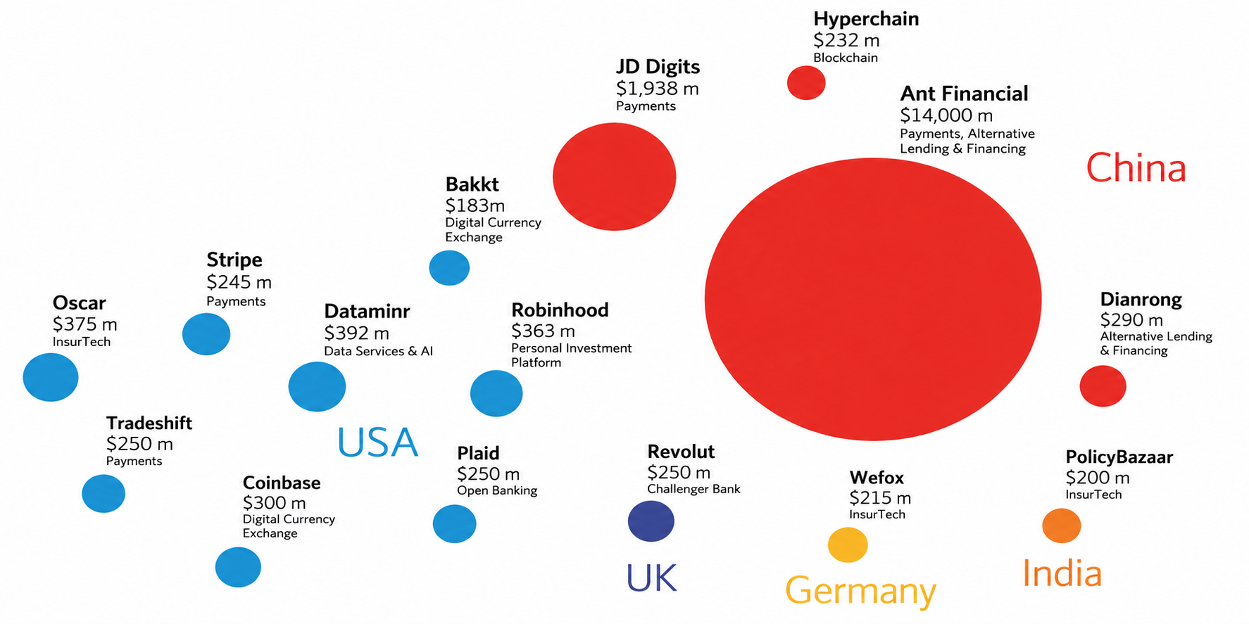
Financial Technology – Wealth Tech Cases – Global Fintech VC Investment - Top 15 Global Deals (2018)
United States and China account for all but three of the top fifteen deals in 2018. Other countries include the United Kingdom, Germany and India.
Notes:
Engagement and Activity Slides
Note:
Include at least one engagement element where appropriate:
Think–Pair–Share
Mini task
Poll or reflection question
Suggested duration: 3–5 minutes
Activities shall align with learning outcomes

Slide 62
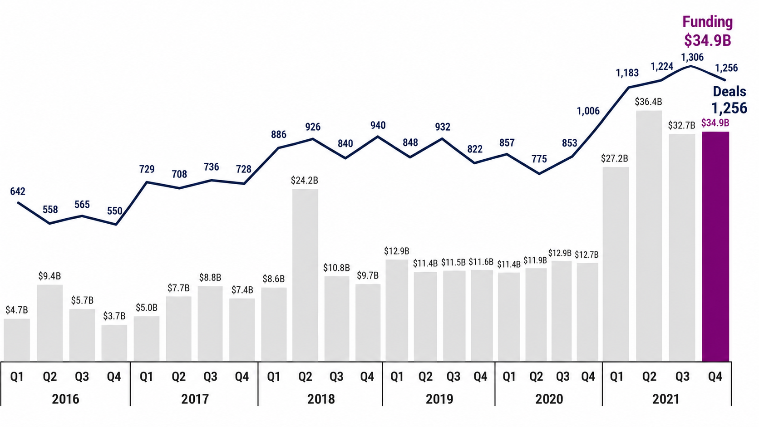
Global Fintech VC Investment - Top 15 Global Deals (H1’22)
Notes:
Engagement and Activity Slides
Note:
Include at least one engagement element where appropriate:
Think–Pair–Share
Mini task
Poll or reflection question
Suggested duration: 3–5 minutes
Activities shall align with learning outcomes

Slide 63
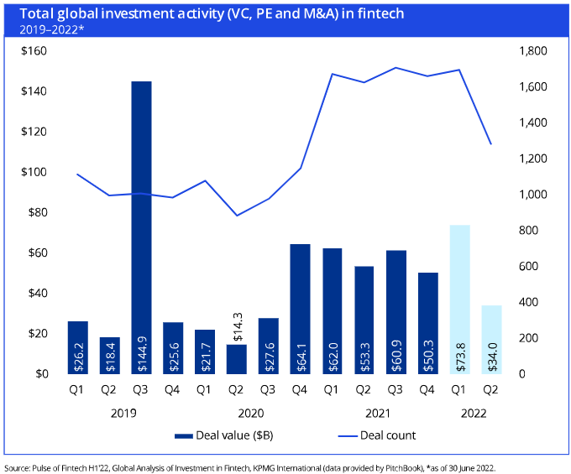
Global Fintech VC Investment - Top 15 Global Deals (H1’22)
Global investment in fintech dropped
from $111.2
billion across 3,372 deals in H2’21 to $107.8
billion across 2,980 deals in H1’22….(6
months period).
The Asia-Pacific region attracted $41.8 billion, while the
Americas attracted $39.4 billion – of which the US accounted for $34.9 billion, and the EMEA region attracted
$26.6 billion.
Notes:
Engagement and Activity Slides
Note:
Include at least one engagement element where appropriate:
Think–Pair–Share
Mini task
Poll or reflection question
Suggested duration: 3–5 minutes
Activities shall align with learning outcomes

Slide 64
What is FinTech?
1.1. Singapore, ASEAN Capital of Fintech
Singapore is at the heart of the tech industry’s explosive popularity across Southeast Asia. The country has emerged as a hub for technology entrepreneurs, and fintech is one of its front-running sectors.
For centuries, With 40% of all fintech companies across Southeast Asia based in the country, Singapore has earned itself the title of the “ASEAN capital of Fintech.” The country’s robust regulatory regime, policy-level support, and ease of doing business, have resulted in it being home to over 750 fintech companies so far.
Notes:
Engagement and Activity Slides
Note:
Include at least one engagement element where appropriate:
Think–Pair–Share
Mini task
Poll or reflection question
Suggested duration: 3–5 minutes
Activities shall align with learning outcomes

Slide 65
Unbundling – Breaking Up the Value Chain
A booming e-commerce and consumer services sector, with the likes of Grab, Lazada and Sea Group setting up shop within the country, has only added to the lure of fintech solutions, such as PayTech, in Singapore.
And while hirers are largely looking to keep workforce levels steady in Q3 2021, the finance and insurance sectors are among those with the strongest job outlooks for the quarter.
Notes:
Engagement and Activity Slides
Note:
Include at least one engagement element where appropriate:
Think–Pair–Share
Mini task
Poll or reflection question
Suggested duration: 3–5 minutes
Activities shall align with learning outcomes

Slide 66
INTRODUCTION TO FINTECH
Southeast Asia’s
Top 5 Largest
FinTech Unicorns

Slide 67

Southeast Asia’s Top 5 Largest Fintech Unicorn
1.1. Grab – US $40 Billion
Grab is a technology company headquartered in Singapore and Indonesia. In addition to transportation, the company offers food delivery and digital financial services via a mobile app. Grab currently operates in Singapore, Malaysia, Cambodia, Indonesia, Myanmar, the Philippines, Thailand and Vietnam, and is one of Southeast Asia’s biggest technology companies.
For The company, which has been looking to tap into Southeast Asia’s digital banking opportunity, secured a digital full bank license in Singapore in a partnership with local telco Singtel in 2020. The joint venture also applied for a digital banking license in Malaysia in July, and recently invested in Bank Fama International, an
Notes:
Engagement and Activity Slides
Note:
Include at least one engagement element where appropriate:
Think–Pair–Share
Mini task
Poll or reflection question
Suggested duration: 3–5 minutes
Activities shall align with learning outcomes

Slide 68
What is FinTech? (Traditional Banking)
Grab began trading on the Nasdaq stock exchange on December 2nd after a record US$40 billion merger with a special purpose acquisition company (SPAC). The company raised more than US$4 billion in additional capital as part of the SPAC deal.
Notes:
Engagement and Activity Slides
Note:
Include at least one engagement element where appropriate:
Think–Pair–Share
Mini task
Poll or reflection question
Suggested duration: 3–5 minutes
Activities shall align with learning outcomes

Slide 69

Southeast Asia’s Top 5 Largest Fintech Unicorn
1.1. GoTo – US $28 Billion
GoTo was formed in May 2021 through the merger of ride- hailing and food delivery company Gojek and local e- commerce leader Tokopedia, the two most prominent unicorns in Indonesia. The firm comprises three business arms: Gojek, an on-demand multi-service platform and super app; GoTo Financial, which covers services such as GoPay, GoSure, GoInvestasti, GoPayLater, Midtrans and Moka; and Tokopedia, one of Indonesia’s most popular online shopping portals.
Headquartered in Jakarta, Indonesia, GoTo counts over 100 million monthly active users, more than 11 million merchants, and over 2 million drivers in an ecosystem that represents 2% of Indonesia’s US$1 trillion gross domestic product (GDP)
Notes:
Engagement and Activity Slides
Note:
Include at least one engagement element where appropriate:
Think–Pair–Share
Mini task
Poll or reflection question
Suggested duration: 3–5 minutes
Activities shall align with learning outcomes

Slide 70
What is FinTech? (Traditional Banking)
GoTo made its debut on the Indonesia Stock Exchange on April 11, 2022, raising an estimated US$1.1 billion from its initial public offering (IPO). The total amount raised, the third- largest IPO in Asia and fifth-largest globally this year, represented a market capitalization of US$28 billion. The funds will be used to drive the company’s expansion into high-growth markets such as Singapore and Vietnam, as well as drive customer engagement.
Notes:
Engagement and Activity Slides
Note:
Include at least one engagement element where appropriate:
Think–Pair–Share
Mini task
Poll or reflection question
Suggested duration: 3–5 minutes
Activities shall align with learning outcomes

Slide 71

Southeast Asia’s Top 5 Largest Fintech Unicorn
1.1. Sea – US $4.8 Billion
Sea was awarded a digital full bank license in Singapore in 2020, and last year, its e-commerce arm Shopee acquired Indonesian lender Bank Kesejahteraan Ekonomi with the aim of transforming it into a digital bank.
Sea started trading on the New York Stock Exchange on October 20, 2017 after raising US$884 million from its listing. Sea was valued US$4.8 billion at the time, according to CB Insights.
Notes:
Engagement and Activity Slides
Note:
Include at least one engagement element where appropriate:
Think–Pair–Share
Mini task
Poll or reflection question
Suggested duration: 3–5 minutes
Activities shall align with learning outcomes

Slide 72

Southeast Asia’s Top 5 Largest Fintech Unicorn
1.1. OvO – US $2 Billion
Ovo, officially PT Visionet Internasional, is a digital payment service based in Jakarta, Indonesia, and one of the largest e-wallets in the country for both online and offline transactions.
In addition to its core digital payment services, Ovo has also moved into other financial services. Ovo offers lending services through Taralite (PT Indonusa Nusa Sejahtera), a peer-to-peer (P2P) lending company that it acquired in 2019, as well as investment products under Ovo Invest, and insurance products under Ovo Proteksi in collaboration with partners.
Notes:
Engagement and Activity Slides
Note:
Include at least one engagement element where appropriate:
Think–Pair–Share
Mini task
Poll or reflection question
Suggested duration: 3–5 minutes
Activities shall align with learning outcomes

Slide 73
What is FinTech? (Traditional Banking)
A 2021 report by Boku, a US mobile payments company, revealed that Ovo controlled 38.2% of the domestic market share for digital wallets in 2020 and had the biggest user base compared to its competitors, with more than 100 million users.
In October 2021, news broke that Grab had taken majority ownership of Bumi Cakrawala Perkasa, Ovo’s parent, increasing its stakes from 39% to 90%. Ovo was valued at about US$2 billion at the time.
Notes:
Engagement and Activity Slides
Note:
Include at least one engagement element where appropriate:
Think–Pair–Share
Mini task
Poll or reflection question
Suggested duration: 3–5 minutes
Activities shall align with learning outcomes

Slide 74

Southeast Asia’s Top 5 Largest Fintech Unicorn
1.1. Bitkub – US $1 Billion
Bitkub is a Thailand-based cryptocurrency exchange, operated by Bitkub Online under its parent group Bitkub Capital Group Holdings. Bitkub was among the first exchanges to receive a digital asset license from the country’s Securities and Exchange Commission, in 2019. It claims to be the largest cryptocurrency exchange in the country, with a share of 90% of cryptocurrency transactions based on 2021 data from regulated exchanges.
In November 2021, Siam Commercial Bank Group announced that it would acquire a 51% stake in the company for US$537 million, valuing Bitkub at over US$1 billion and making it one of Thailand’s first unicorn startup companies.
Notes:
Engagement and Activity Slides
Note:
Include at least one engagement element where appropriate:
Think–Pair–Share
Mini task
Poll or reflection question
Suggested duration: 3–5 minutes
Activities shall align with learning outcomes

Slide 75
What is FinTech? (Traditional Banking)
Bitkub aims to increase its customer base to 7 million and expand its services abroad this year. In particular, it’s looking to penetrate neighboring markets such as Malaysia, the Philippines and Laos, and is currently studying the feasibility of expanding overseas to improve the company’s competitiveness and build a customer base abroad, according to a January 2022 report by Bangkok Post.
Notes:
Engagement and Activity Slides
Note:
Include at least one engagement element where appropriate:
Think–Pair–Share
Mini task
Poll or reflection question
Suggested duration: 3–5 minutes
Activities shall align with learning outcomes

Slide 76
SUMMARY
By the end of this session:
Customer-Centric Shift: FinTech has transformed finance by prioritizing user experience, transparency, and accessibility over institutional convenience .
Technology as the Catalyst: AI, Big Data, and mobile connectivity are empowering startups to "unbundle" traditional banking into highly efficient, single-purpose solutions.
Global Disruption: Despite hurdles in regulation and scaling , FinTech is a permanent disruptive force, heavily driven by massive growth in Asian markets.
The Ultimate Goal: Fostering financial inclusion, lowering costs, and adapting to the demands of the modern, digital-first consumer.
Notes:
Summary and Closure Slides
Note:
Summarise 3–5 key takeaways
Reinforce main ideas
Indicate CLO coverage where appropriate
Include:
Upcoming topics
Required reading
Tutorial / lab / assessment linkage

Slide 77

THANK YOU
Shuhaida Bt M Shuhidan
DEPARTMENT OF COMPUTING
shuhaida.shuhidan@utp.edu.my
01-03-31

